Slide 1
COMP1204: Revision
Oli Bills
ofb@ecs.soton.ac.uk

Slide 2
What will be in the exam?
The Unix family of operating systems (Linux, BSD, OS X) - The Unix philosophy and environment; files, processes, pipes, filters and basic utilities - Data manipulation tools; editors, grep and other utilities - Scripting - Shells and shell programming - Program development tools Structured documents and markup languages - LaTeX - XML-based languages (HTML, DocBook) Database systems - Rationale behind Database Systems - Database Modelling using the Entity-Relationship Model - Data Models and Data Sublanguages - Practical SQL The Relational Model - Relations, domains, attributes, keys, dependencies - Normalisation

Slide 3
What will be in the exam?
Unix
XML and Structured Data
Database Systems
Relational Model
Relational Algebra
Normalisation
SQL
33 questions, 48 parts, 100 marks
Questions vary from 1 to 5 marks
Understanding based, not just memorisation!

Slide 4
Today
The Unix family of operating systems (Linux, BSD, OS X) - The Unix philosophy and environment; files, processes, pipes, filters and basic utilities - Data manipulation tools; editors, grep and other utilities - Scripting - Shells and shell programming - Program development tools Structured documents and markup languages - LaTeX - XML-based languages (HTML, DocBook) Database systems - Rationale behind Database Systems - Database Modelling using the Entity-Relationship Model - Data Models and Data Sublanguages - Practical SQL The Relational Model - Relations, domains, attributes, keys, dependencies - Normalisation

Slide 5
Structured Data

Slide 6

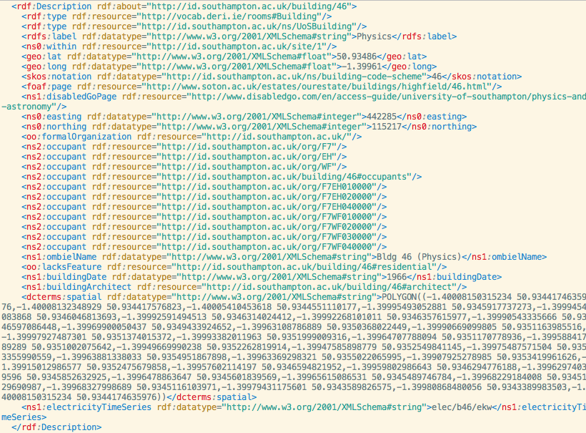
Human vs. Machine
Human-readable
Text, images, forms
Mostly unstructured
Focus on usability
Machine-readable
Needs to be structured
Machines can’t yet “read”
Focus on efficiency
Generally not human readable/writable

Slide 7
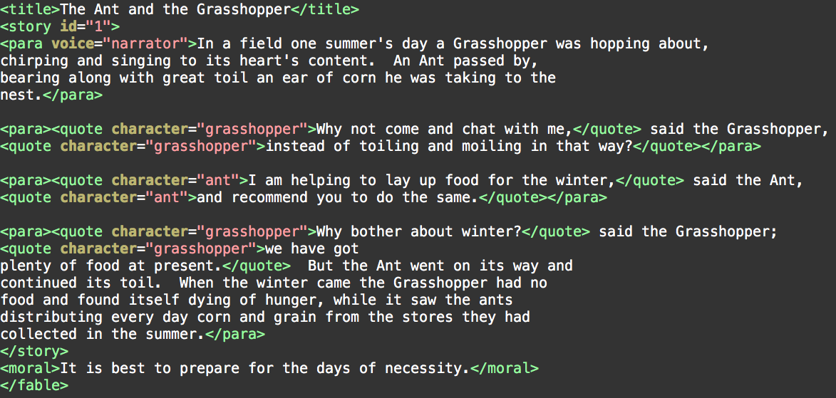
Markup: From Human to Machine
We can add further information as well

Slide 8
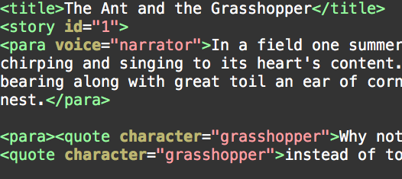
SGML: Standard Generalised Markup Language
An ISO standard for defining Markup Languages (1986)
Marking up the content
A Super set of all markup languages
Seperates structure from content
Metalanguage: Describing formatting and markup languages
Tags: <tag> … </tag>
Attributes:
<tag attribute=”value”>
Content
<tag>Content Goes Here</tag>

Slide 9
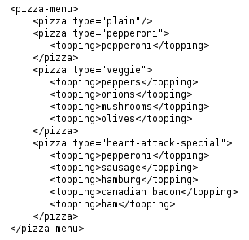
XML
XML: eXtensible Markup Language
Hierarchical
Designed to carry data, not display data
No defined tags
You define your own XML tags
Meta-tools to define purpose of specific tags
DTD: Document Type Definition
Schema
Unicode
W3C recommendation (1998)

Slide 10
XML Syntax
All XML elements must have a closing tag
XML tags are case sensitive
XML elements must be properly nested
XML Documents must have a root element
XML attributes must be quoted e.g. <tag attr=“…”>

Slide 11
The XML Suite
Syntax: defines how XML should be written (write it correctly)
Namespaces: global semantic partitions (avoid name conflicts)
Schema: semantic definitions or validity (write it properly!)
XSLT: language to transform XML documents (format it!)
e.g., stylesheets (much more powerful than CSS)
XPATH - individual items in XML documents (Locate data)
XQUERY - generalised query language for XML-based databases (query it)

Slide 12
Schema
We want a way to define a correctly-formatted XML file with our own tags, attributes and structure
Can be used to ensure a valid file
Can be used as a template
Can be used to identify any errors
Eases parsing
Can build rules based on tags and attributes
Greater effiency
Various elements
Elements, sequences, types, attributes

Slide 13
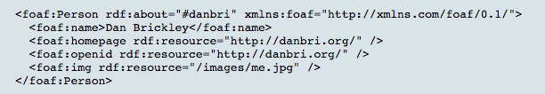
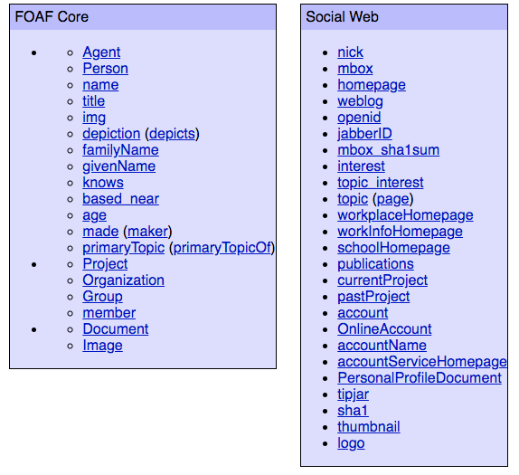
Namespaces
XML files can reference and include other files
Take the university for example
There are XML files which contain
People
Buildings
Rooms
There are external XML files which link in
Bus times
Roads
You define your own tags for your things (e.g. person, building), but other people may also define tags with the same name, which are different to yours
The solution: Namespaces
You define your tags in your namespace
They define their tags in their namespace
No conflicts!
Define using xmlns
FOAF: Friend of a Friend

Slide 14
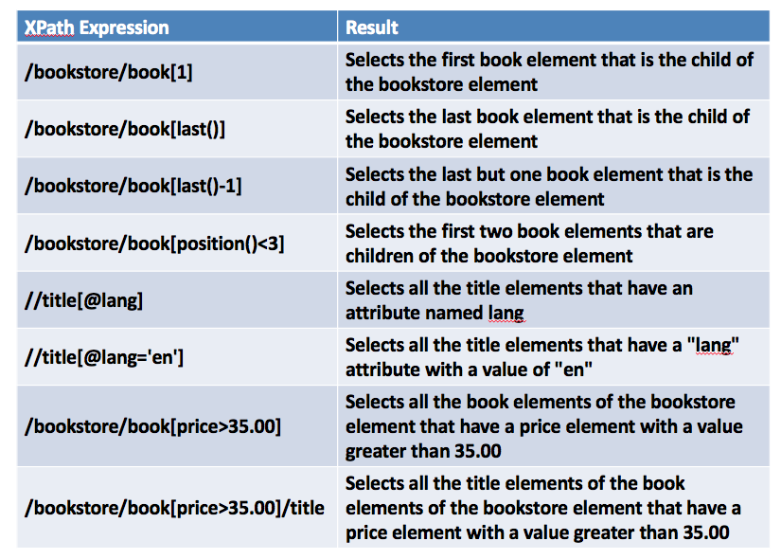
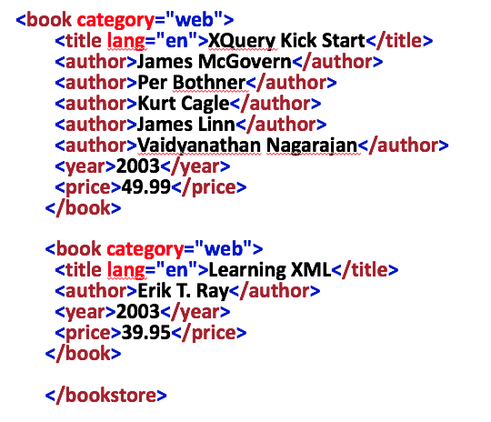
XPATH
Used to navigate through elements and attributes in XML documents

Slide 15
XPATH: Reminders
Getting a node
Getting all nodes
Indirect nodes
Getting attributes
Getting text
Getting everything
Numerical referencing
Filtering by node
Filtering by attribute
Boolean logic
Navigation
String functions

Slide 16
XPATH: Reminders
Getting a node: /path/to/element
Getting all nodes: //node, //*, /node/*/node2
Indirect nodes: /node1//node3
Getting attributes: /node/@Attribute
Getting text: /node/text()
Getting everything: //text()
Numerical referencing: /node[n]
Filtering by node: //Node1[Node2]
Filtering by attribute: //Node1[@Attribute=“Value”]
Boolean logic: //Node|//Node2, //Node[@id=1 or @id=2]
Navigation: . And ..
String functions: contains, string-length, starts-with etc.

Slide 17
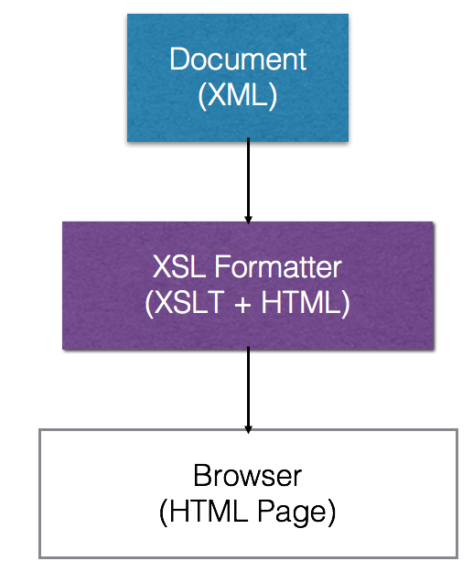
XSLT
A step beyond CSS
Just decides how to display certain elements
eXtensiable Stylesheet Language Transformations
It transforms the input -> output
Use to add/remove elements to/from output file
Re-arrange/sort elements
Perform tests, make decisions
Hide/display
Uses XPATH

Slide 18
XSLT: Putting it to use
Using XPath to build a new document
<xsl:stylesheet> or <xsl:transform> (the same)
Define the root element
<xsl:template match=”XPath">
Contains the rules, applied to the match
<xsl:for-each select=”XPath">
Loop over the given path
<xsl:value-of select=”XPath”>
Display the value of the given path
<xsl:if test="expression">
Allows conditional branches
More tags: https://www.w3.org/TR/2017/REC-xslt-30-20170608/

Slide 19
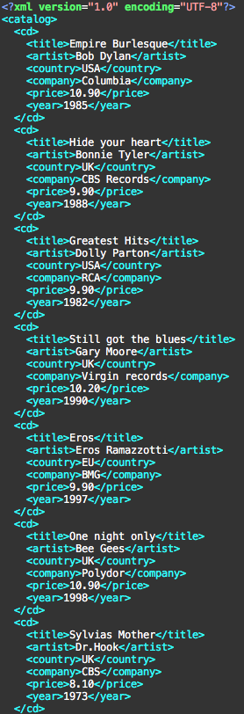
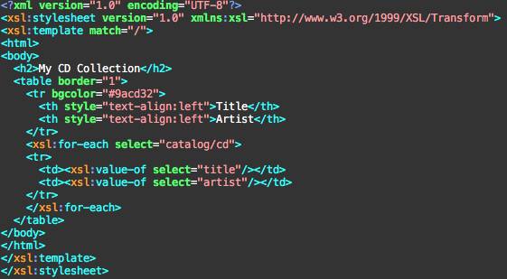
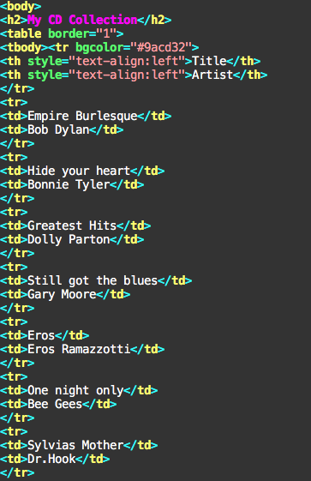
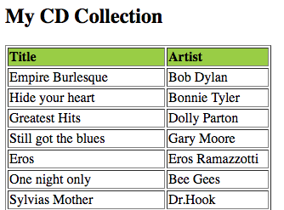
+
=

Slide 20
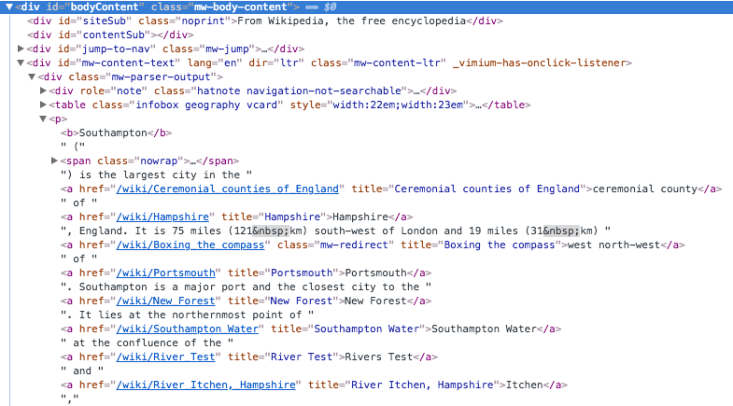
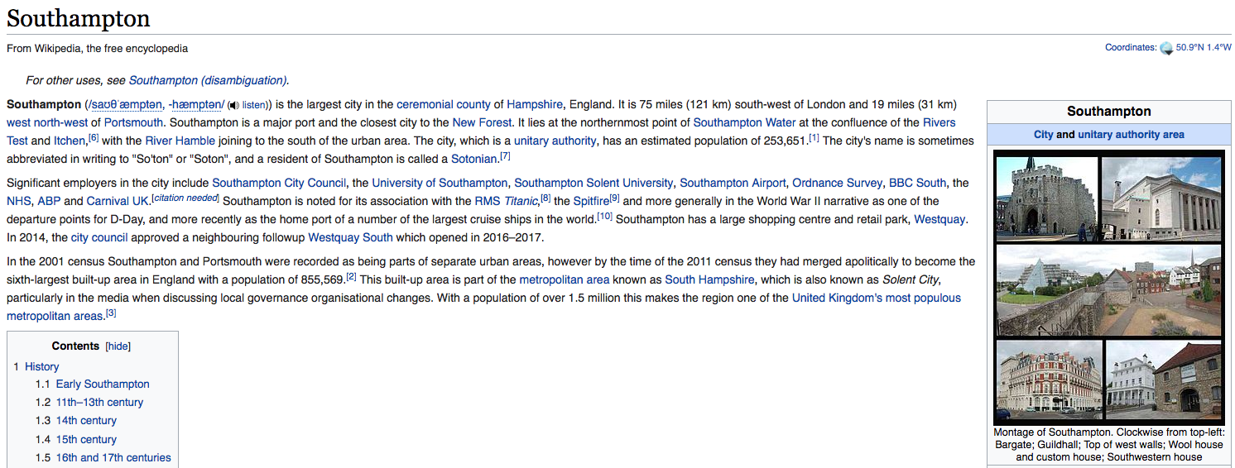
What about HTML?
HTML is an application of SGML
HTML tells you how to display tags, whereas XML tells you what the data means
Rules based on tags (e.g. b = bold)
XHTML is an application of XML (more restrictive than SGML)
Modern HTML5 while based on the ideas in SGML is not SGML

Slide 21
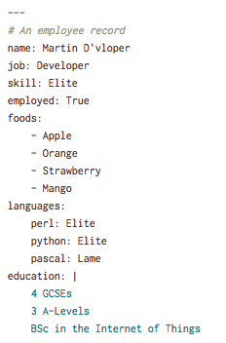
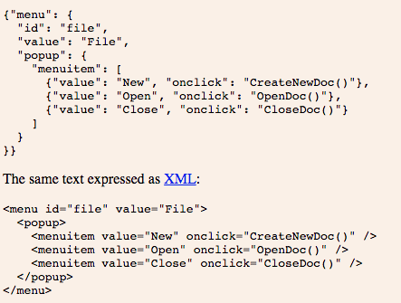
Other forms of structured data
JSON: JavaScript Object Notation
YAML: Yet Another Markup Language

Slide 22
Exam Question
Which of these statements about XML is not true?
a) XML tags are case sensitive
b) XML tags must have closing tags
c) XML attributes must be quoted
d) XML tags must have namespaces
XML tags can be in namespaces to allow working with multiple similarly named tags but they are not required

Slide 23
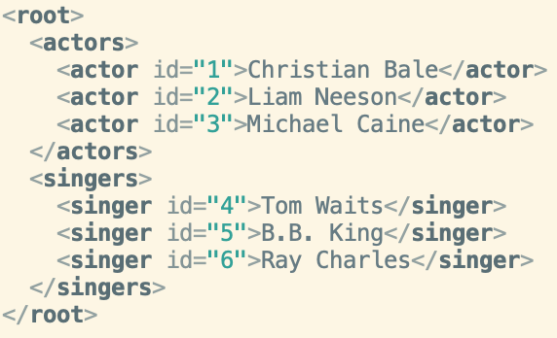
Exam Question
Get all the ID values of all actors
a) //actor/id
c) //actor[@id]
b) //actor/*/@id
d) //actor/@id
We select all the actor nodes then grab the id @attribute

Slide 24
Exam Question
Get just the name of the third singer
a) /singer[3]
c) //singers/singer[3]/text()
b) /singer[3]/text()
d) //singer[@id=6]
Get the singers element, then get the third singer, then get the text. //singer[3] would be fine as well.

Slide 25
Normalisation

Slide 26
What is Normalisation?
What we want to avoid
Redundant data
Why do we want to avoid it
Efficiency
Maintenance
Size
How do we do it?
Divide database into multiple tables
Define relationships between them

Slide 27
The Steps to being normal
First normal form: atomicity, find keys
Second normal form: remove partial dependencies
Non-key attributes must depend on every part of the primary key
Third normal form: remove transitive dependencies
No non-key attributes depend on another non-key attribute
Boyce-Codd normal form: Stricter than 3NF
Every attribute must be a fact about a key
There’s also fourth and fifth normal form (but we don’t really worry about those)…

Slide 28
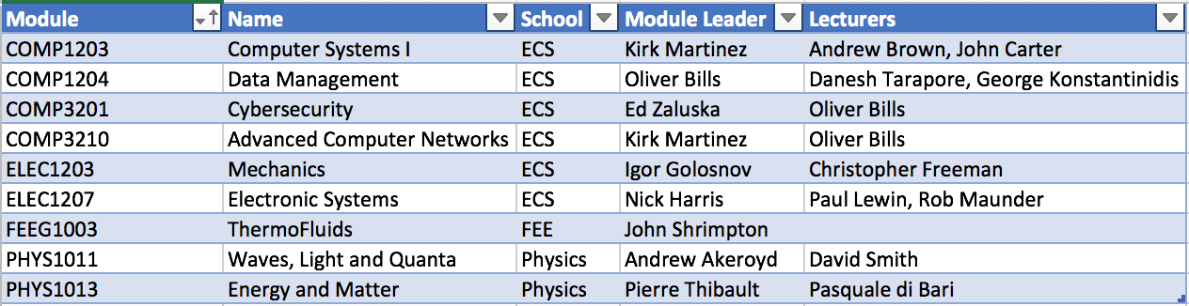
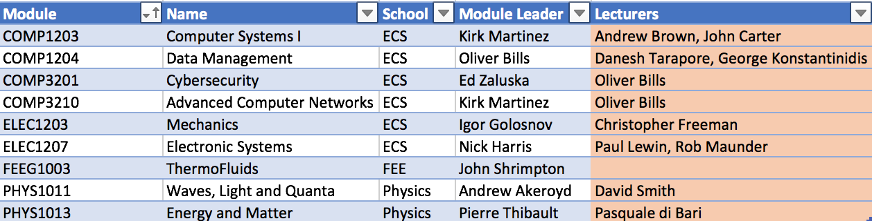
Pre-Normalisation
1) Are there any non-atomic values or repeating groups?

Slide 29
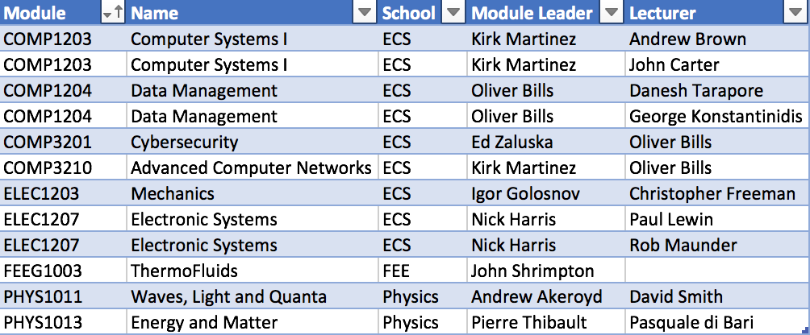
Converting to 1NF
Remove the repeating group of attributes to form new entities

Slide 30
What are the problems?
We have to leave nulls if we want to insert a new module with no leader/lecturers yet
We have to modify multiple rows to update the same information (name, school, leader)
Removing a module potentially removes the people

Slide 31
Identify functional dependencies
Reminder: A -> B if each value of A is associated with exactly one value of B We say that B is functionally determined by A (knowing A gives us B)
Primary Key: {Module, Lecturer} -> {Name, School, Module Leader}
{Module} -> {Name, School, Module Leader}
{Name} -> {Module, School, Module Leader}
{Module Leader} -> {School}
{Lecturer} -> {School}

Slide 32
Identify partial dependencies
Reminder: We are looking for any non-key attributes which dependent on only part of the primary key.
Primary Key: {Module, Lecturer} -> {Name, School, Module Leader}
{Module} -> {Name, School, Module Leader}
{Name} -> {Module, School, Module Leader}
{Module Leader} -> {School}
{Lecturer} -> {School}

Slide 33
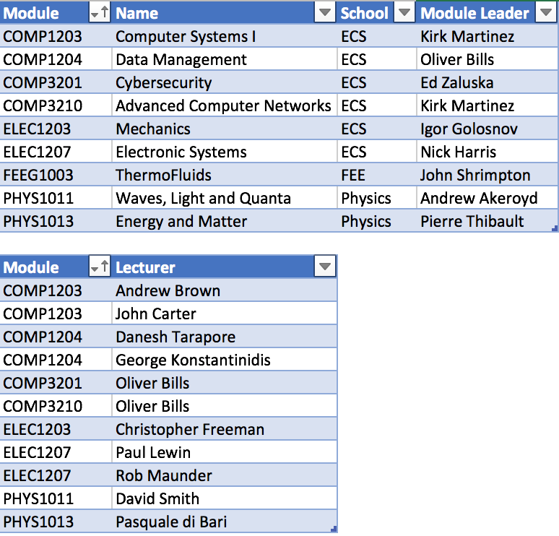
Converting to 2NF
Reminder: Your keys uniquely identify a row
Primary key: {Module}
Candidate keys: {Module} or {Name}
Why? Unique, non-null, shouldn’t change
We have taken out the attributes dependent only on Module and formed a new relation.
We are then left with the modified original relation containing Module and Lecturer.
Now, every attribute in both tables depends on the whole key.
Primary key: {Module,Lecturer}

Slide 34
Looking at the problems
Resolved
We can add new modules and lecturers separately
We can update module information only once
Remaining
Updating school remains a challenge

Slide 35
Identify transitive dependencies
Reminder: A transitive dependency is where A -> B and B -> C, thus A -> C
It is arguable whether the school is dependent on the module or the module leader running the module.
Here, we assume the module leader functionally determines the school, which matches with the data (the module is in the school of the leader)
{Module Leader} -> {School}
Where it’s important to consider the business logic, not just the data – consider future data when modelling.

Slide 36
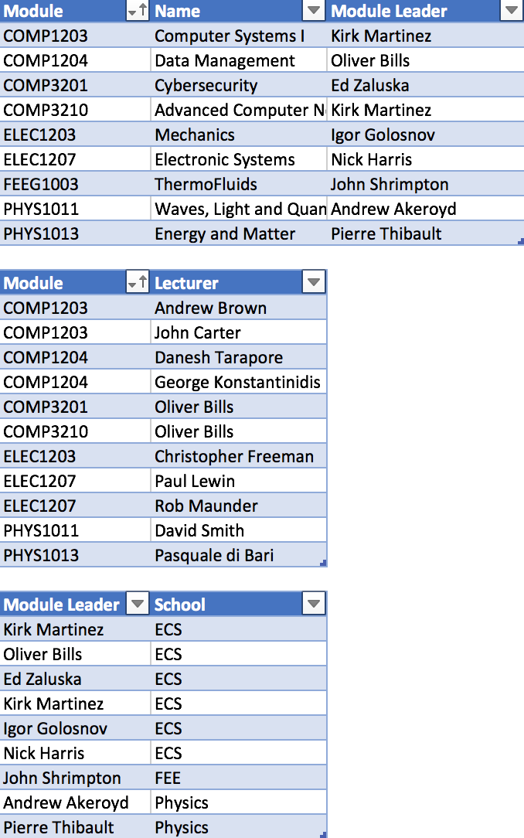
Converting to 3NF
{Module} -> {Module Leader}
{Module Leader} -> {School}
Therefore {Module} -> {Module Leader} -> {School}
So split out

Slide 37
Is it BCNF?
Requirements
Every attribute relates to the key (every determinant is a candidate key)
R1
Keys {Module} and {Name}
{Module} or {Name} -> Module Leader
{Module Leader} -> nothing
R2
Keys {Module}
{Module} -> {Lecturer}
{Lecturer} -> nothing
R3
Keys {Module Leader}
{Module Leader} -> {School}
{School} -> nothing
So we have BCNF

Slide 38
Why is it better?
No redundancy
Less storage space required
Efficiency
Less data to search through -> faster queries
No duplication
Better integrity
Only have to modify something in 1 place
Less chance of mistakes
Changes can cascade across relations
Example: Remove a person and anything related to them

Slide 39
What are the consequences?
More tables
More complexity
More relationships
Queries become more complex
But it’s worth it!
How many times have you been annoyed by a spreadsheet?

Slide 40
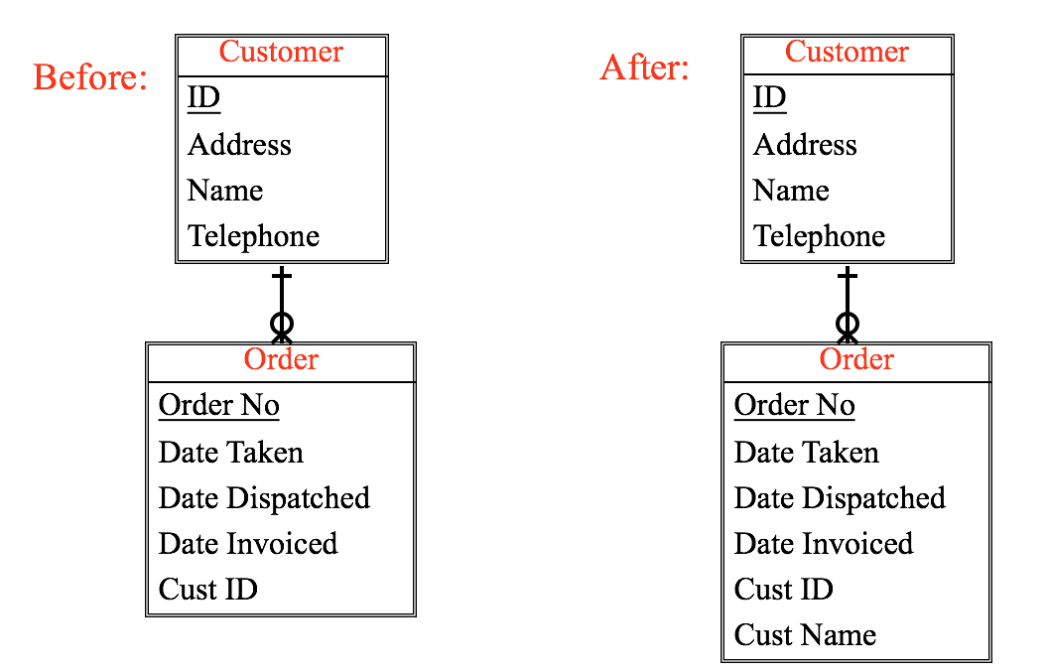
Denormalisation?
Driven by the need to improve query speed
At the expense of less normalisation
More complex operations required to updates, deletions and insertions to avoid integrity issues
Including the Customer Name in the order, as well as in the customer table

Slide 41
Exam Question
A relation is in 1NF if it contains no…
a) Functional Dependencies
b) Atomic Values
c) Repeating Groups
d) Null values
To be in 1NF, all values must be atomic and there can be no repeating groups

Slide 42
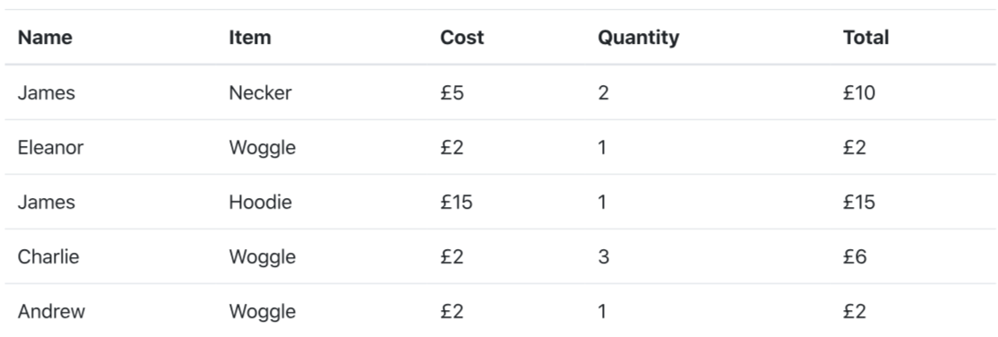
Exam Question
Consider the ORDERS relation and its domain. What is the most appropriate primary key?
a) (Name,Item)
c) (Name)
b) (Name,Item,Quantity)
d) (Name,Total)
Name and Item is the smallest, unique identifier of each order

Slide 43
Exam Question
Which statement is correct?
a) This is 2NF, every non-prime attribute is dependent on entire key
b) This is 2NF, all functional dependencies are related to the key
c) This is not 2NF, the name attribute contains duplicates
d) This is not 2NF, non-prime attributes do not depend on entire key
In 2NF, non-key attributes must depend on every part of the primary key. Cost does not

Slide 44
Exam Question
Consider the relation R(A,B,C,D,E) in BCNF. The only key is (A,B,C). Which functional dependency is guaranteed to hold for R?
a) BCE -> A
b) ABC -> E
c) A -> B,C
d) ABE -> D
In BCNF, every attribute must be determined by the whole key.

Slide 45
Data Modelling

Slide 46
Three types of Data Modelling
Conceptual -> Ideas
Logical -> High Level Design
Physical -> Low Level

Slide 47
Conceptual Model
Directly from the requirements and domain
No thought of database design
Entity names and relationships and sometimes attributes

Slide 48
Logical Model
Identification of attributes
Identification of attribute types
Upload history simplified – multiple photos
Split out Member

Slide 49
Physical Model
Consideration of database structure
Actual tables and fields
Implementation of relationships (e.g. keys, join tables), indexes etc.
Introduced foreign keys
Introduced the join table

Slide 50
Types of relationships
Cardinality:
one-to-one (e.g., an employee has one address)
one-to-many (e.g., an employee may be involved in multiple projects)
Many-to-many (e.g., a number of employees may be involved on many projects)
Identifying/non-Identifying: when foreign key is/not part of the primary key of a child table.
Mandatory/Optional
Employee must have a department
Department may have one or more employees
An EmployeeProject entity must have 1 employee and 1 project

Slide 51
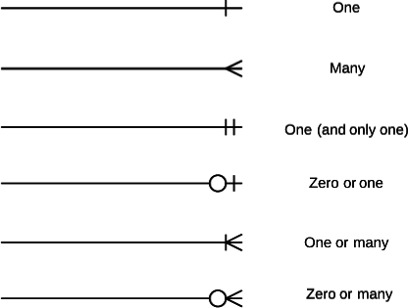
Relationships
(Crow’s Foot Notation)

Slide 52
Cardinality and Modality
Cardinality and Modality are the indicators of the business rules around a relationship.
Cardinality refers to the maximum number of times an instance in one entity can be associated with instances in the related entity.
Modality refers to the minimum number of times an instance in one entity can be associated with an instance in the related entity.

Slide 53
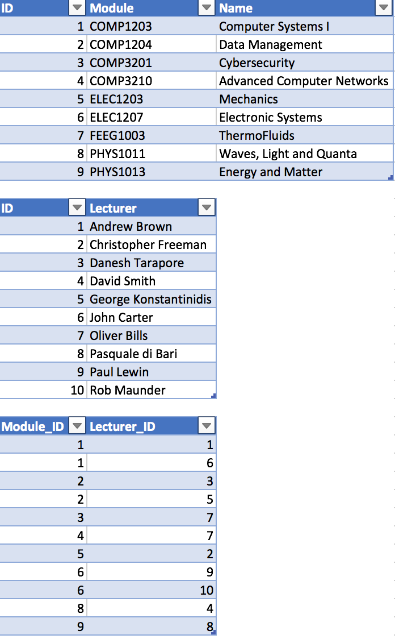
Surrogate Keys: ID Fields
Automatic ID fields are what we term surrogate keys: They have no business meaning
Surrogate keys are attributes created and maintained by the system to aid in uniquely identifying an instance of an entity – they do not occur in the real world
They are used because natural keys aren’t generally stable, consistent or efficient to use in a database system
They stand in place of the natural keys for technical purposes only, and are added as part of physical design – after the logical modelling and normalisation
But you don’t need to use them everywhere – some developers want an ID in every table…

Slide 54
Database Systems

Slide 55
What is SQL
SQL: Structured query language
Specifies a Data Definition Language (DDL)
Tables and views (virtual tables).
Convert a data model to a (physical) database
Specifies a Data manipulation (DML)
Programmatic data manipulation
Declarative (desired result)
INSERT, DELETE, UPDATE or retrieve (SELECT) data.
Enforces Data integrity:
Referential integrity
Transactions
Checks keys for consistency
Access control: security
Data sharing: by concurrent users

Slide 56
Data Definition
Create Database
Create Table
Define Primary Keys
Define Foreign Keys
action the DBMS should take if we update or delete a key value in the referenced table.
how will we enforce referential integrity.

Slide 57
Create a Table
CREATE TABLE Table
(
Field field_type [Options],
Field field_type [Options],
Field field_type [Options],
…
);

Slide 58
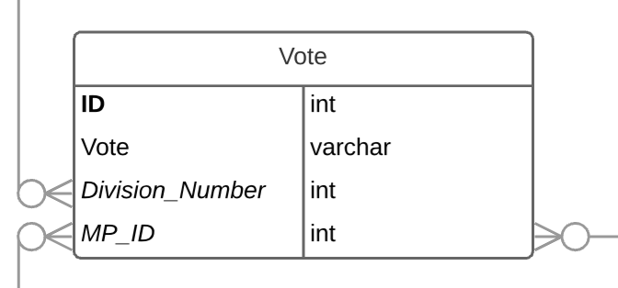
Getting more Complex
create table Vote ( ID integer constraint Vote_pk primary key autoincrement, Vote varchar(10), Division_Number integer constraint Vote_Division_Number_fk references Division on update cascade on delete cascade, MP_ID integer constraint Vote_MP_ID_fk references MP on update cascade on delete restrict );
Deleting a Division will remove all associated Votes (cascade) It is not possible to remove an MP who has votes (restrict)

Slide 59
Maintaining Referential Integrity
ON DELETE
When the parent record is deleted
ON UPDATE
When the parent key is updated
Not overly useful when it’s an automatically generated key
Potential actions:
CASCADE the deletion/updates to the referring tables
May not be appropriate
Delete a booking, you don’t want to delete the member!
Delete a member when they’ve left, you don’t want to delete they had a booking
RESTRICT: Prevent the parent being updated/deleted
SET DEFAULT: Set the key value to the default
SET NULL: Set the key value to NULL

Slide 60
Summary
PRIMARY KEY: Define the primary key
AUTOINCREMENT: Automatically incrementing integer
CONSTRAINT: Name a constraint
NOT NULL: Prevents NULL values
REFERENCES: Defines foreign keys and referential integrity

Slide 61
Inserting
INSERT INTO Table(Column1,Colum2,Column3) VALUES(”Value1”,”Value2”,3)
For example
INSERT INTO Party (ID,Name) VALUES (1,'Labour');

Slide 62
Updating and Deleting
UPDATE Table
SET Field=Value
WHERE Field=Condition
UPDATE MP SET Name = ‘Sir John Bercow’ WHERE Name = ‘John Bercow’
DELETE FROM Table
WHERE Field=Value
DELETE FROM Party WHERE Name = ‘Conservative’

Slide 63
SELECT
Made up of a number of clauses
Retrieves tuples and attributes (rows and columns) from one or more tables or views
to apply conditions on (WHERE)
Order of clauses is important:
SELECT columns
[INTO new table]
FROM table or view
[WHERE specific rows or a join is created]
[GROUP BY grouping conditions (columns) – HAVING group-property (specific rows)]
[ORDER BY ordering criterion ASC | DESC]

Slide 64
SELECT
SELECT * FROM Table
* Means all columns
SELECT Column,Column2… FROM Table
Specify specific columns
SELECT Columns FROM Table WHERE Conditions
Specify conditions on results returned
SELECT Columns FROM Table LIMIT Number
Limit the number of results
SELECT * FROM Table ORDER BY Column ASC/DESC
Specify an ordering
You can combine them but they must be in the right order

Slide 65
Aggregating
SELECT column_name, aggregate_function(another_column)
FROM table_name
WHERE column_name=operator_value
GROUP BY column_name;
Two most useful aggregation functions
COUNT
SUM

Slide 66
Joins
Now we need a way to bring our data together in am more useful way
We do this using JOINS
You split your relations to avoid redundant data, now you want to bring them back together…
Join column is usually Key column
Nulls will never join
Need compatible data types

Slide 67
Join Types
INNER join: returns just rows with matching keys (join column values)
RIGHT join: returns all rows from right (second) table, whether they match a row in the first table or not
LEFT join: returns all rows from left (first) table, whether they match a row in the second table or not
FULL OUTER join: Returns all rows from both tables, whether they match or not
67

Slide 68
Joining in SQL
SELECT Table1.*, Table2.* FROM Table1 LEFT JOIN Table2 ON Table1.Column=Table2.Column
Can have multiple tables and multiple joins
You use ON to specify how the tables join to each other

Slide 69
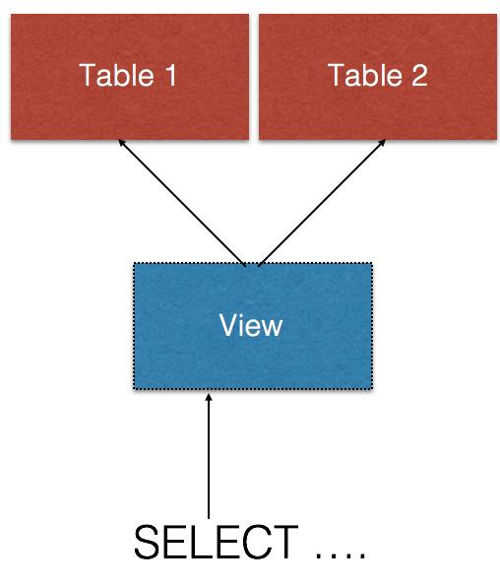
Views
Views are like virtual tables
They have a name
They run a query
You can then query them directly
You can join them against other tables
But they don’t store any data themselves
You create a view by defining the query
CREATE VIEW Name AS SELECT …
You can also remove views by dropping them
DROP VIEW Name
To modify a view
Drop it and recreate it!

Slide 70
Indexes
Data structures associated with a table to support queries
Logically ordered by the values of a key
Usually created for columns you’ll be accessing regularly
Greatly improves database performance
Instead of having to load all records (O(n) linear complexity) where you have to examine each and check if a clause holds
Can quickly lookup and access associated rows based on the value of the index
For example, ID columns, boolean properties etc.
But adds cost to INSERT/UPDATE/DELETE
Also have to update the indexes
Efficiently querying large relations would be impossible without them!

Slide 71
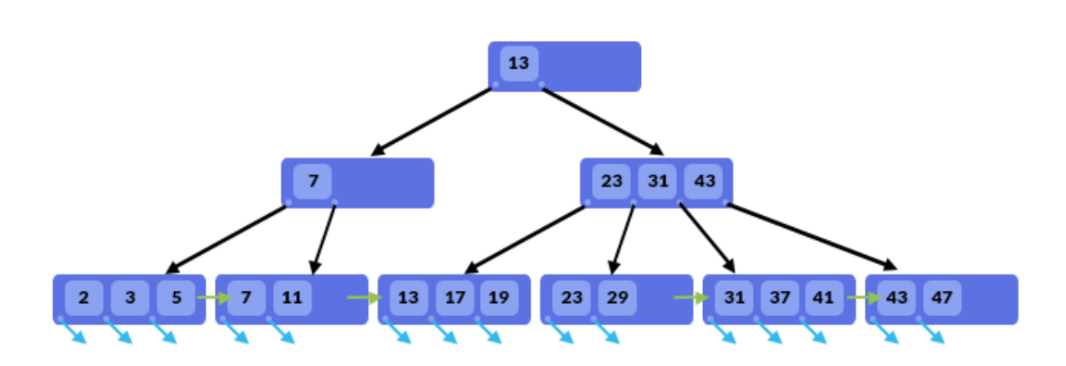
Index Mechanics
Chosen attribute becomes an index key
Sorted, searchable - Logarithmic time, rather than linear time
Don’t have to scan the whole table
Typically implemented as balanced binary trees
Before, Between and After values to follow (can be used for comparisons and quality)
Can also be implemented as hash indexes
Only for equality (= or != operations)
The database system will use the indexes to plan the best possible way to execute your query

Slide 72
Exam Question
Clubs(id,name)
Members(id,firstname,surname)
Clubs_Members(club_id,member_id,year,committee)
Which SQL will provide the year and total number of members that year?
a) SELECT year,count(year) from Clubs_Members
b) SELECT * from Clubs_Members GROUP BY year
c) SELECT COUNT(*) from Clubs_Members GROUP BY year
d) SELECT year,COUNT(*) from Clubs_Members GROUP BY year

Slide 73
Exam Question
Clubs(id,name)
Members(id,firstname,surname)
Clubs_Members(club_id,member_id,year,committee)
How many INNER JOINS would be required to select the firstname, surname and club name of every member?
a) 0
b) 1
c) 2
d) 3

Slide 74
Exam Question
Clubs(id,name)
Members(id,firstname,surname)
Clubs_Members(club_id,member_id,year,committee)
What would be the difference when SELECTing from Members using LEFT JOINs rather than INNER JOIN to Clubs_Members?
a) Members without clubs will appear
b) Clubs without members will appear
c) Members with clubs will not appear
d) No difference

Slide 75
Exam Question
Clubs(id,name)
Members(id,firstname,surname)
Clubs_Members(club_id,member_id,year,committee)
What would be an appropriate UNIQUE index on clubs_members?
a) id
b) club_id
c) club_id,member_id
d) club_id,member_id,year

Slide 76
Good luck!

